Slide 1
State of Missouri
Department of Higher Education and Workforce Development (DHEWD)
WIOA New Staff Orientation and Initial Continuing Notice
Missouri Department of Higher Education and Workforce Development is an equal opportunity employer/program. Auxiliary aids and services are available upon request to individuals with disabilities. All voice telephone numbers on this website may be reached by persons using TTY/TDD equipment via the Missouri Relay Service at 711.
Notes:
Presenter
2020-02-21 20:03:55
--------------------------------------------
During each presentation to orient new participants, new employees, and/or the general public to its WIOA Title I-financially assisted program or activity, in person or over the internet or using other technology, a recipient must include a discussion of rights and responsibilities under the nondiscrimination and equal opportunity provisions of WIOA, including the right to file a complaint of discrimination with the DHEWD or the US DOL Civil Rights Center known as the CRC.. The orientation information must be communicated in appropriate languages and in formats accessible for individuals with disabilities.

Slide 2
State EO Officer
Danielle Smith
Missouri WIOA State Equal Opportunity Officer

Slide 3
Missouri’s-Equal Opportunity Leadership Staff
Danielle Smith,
State EO Officer & DEIA Director
Department of Higher Education and Workforce Development
Harli Rhodes
Director of Policy & EO Investigator
Department of Higher Education and Workforce Development
Isaac Hagan
Senior EO Data Analyst &
Program Benefit Specialist
Department of Higher Education and Workforce Development
Sara Seaver Equal Opportunity Officer Missouri Dept. of Labor & Industrial Relations

Slide 4
Term to Know: WIOA
Workforce Innovation and Opportunity Act 2014(WIOA) is landmark legislation that is designed to strengthen and improve our nation's public workforce system and help get Americans, including youth and those with significant barriers to employment, into high-quality jobs and careers and help employers hire and retain skilled workers.

Slide 5
Term to Know: Recipient
Any entity to which financial assistance under WIOA Title I is extended, either directly from the USDOL or through the Governor or another recipient; excluding the ultimate beneficiaries of the WIOA Title I funded programs or activities.
Notes:
Presenter
2020-02-21 20:03:55
--------------------------------------------
Recipient means entity to which financial assistance under Title I of WIOA is extended, directly from the Department or through the Governor or another recipient (including any successor, assignee, or transferee of a recipient).
The term excludes any ultimate beneficiary of the WIOA Title I-financially assisted program or activity. In instances in which a Governor operates a program or activity, either directly or through a State agency, using discretionary funds apportioned to the Governor under WIOA Title I (rather than disbursing the funds to another recipient), the Governor is also a recipient. In addition, for purposes of this part, one-stop partners, as defined in section 121(b) of WIOA, are treated as “recipients,” and are subject to the nondiscrimination and equal opportunity requirements of this part, to the extent that they participate in the one-stop delivery system. “Recipient” includes, but is not limited to: (1) State-level agencies that administer, or are financed in whole or in part with, WIOA Title I funds;
(2) State Workforce Agencies;
(3) State and Local Workforce Development Boards; (4) LWDA grant recipients;
(5) One-stop operators;
(6) Service providers, including eligible training providers; (7) On-the-Job Training (OJT) employers;
(8) Job Corps contractors and center operators; (9) Job Corps national training contractors;
(10) Outreach and admissions agencies, including Job Corps contractors that perform these functions; (11) Placement agencies, including Job Corps contractors that perform these functions;
(12) Other National Program recipients.

Slide 6
Term to Know: Beneficiary
Beneficiary means the individual or individuals intended by Congress to receive aid, benefits, services, or training from a recipient.
Notes:
Presenter
2020-02-21 20:03:56
--------------------------------------------
Beneficiary means the individual or individuals intended by Congress to receive aid, benefits, services, or training from a recipient.

Slide 7
WIOA Section 188 Nondiscrimination & Equal Opportunity
Because we are a USDOL grant recipient, the Governor has agreed that DHEWD and partners will take specific steps to ensure nondiscrimination in the delivery of programs, services and activities operated throughout the Missouri workforce system.
Federal and state laws prohibit discrimination in both service delivery and employment.
Missouri Governor
Mike Parson

Slide 8
WIOA EO Orientation
Requirements include reviewing the WIOA‘s Complaint Process for:
All staff,
Customers, and the
General Public
Notes:
Presenter
2020-02-21 20:03:55
--------------------------------------------
You will be required to sign the EO Notice and the WIOA Program Complaint and Grievance Notice following the completion of this training.

Slide 9
WIOA Orientation
All Recipients that must comply with WIOA complaint procedures include:
State-level agencies that administer WIOA funds
State Employment Security Agencies (UI)
Core WIOA Partners
State and Local Workforce Development Boards
LWDB Grant Recipients (Service Providers)
One-Stop Operators
Eligible Training Providers
On-the-job (OJT) employers/ Work Experience employers
One-Stop partners
Notes:
Presenter
2020-02-21 20:03:55
--------------------------------------------
We are obligated to monitor all recipients to ensure they are following the WIOA complaint procedures.

Slide 10
Who May File a Discrimination Complaint under WIOA?
Any person, or any specific class of individuals, who believes that they have been or are being subjected to discrimination prohibited under WIOA.
Notes:
Presenter
2020-02-21 20:03:56
--------------------------------------------
Any person (employee, former employee, customer, non-customer or employer) who feels that he/she or another person has been, or is being subjected to discrimination may file a written complaint, either by him/herself or through a representative

Slide 11
WIOA Prohibits Discrimination on the Basis of:
Race/Ethnicity
Religion
Disability
Age
Sex (including pregnancy, childbirth, and related medical conditions, sex stereotyping, transgender status, and gender identity)
National Origin (including limited English proficient (LEP))
Color
Political Affiliation or Belief
Citizenship (participants only)
Participation in a WIOA program, service, or activity (participants only)

Slide 12
How to File a WIOA Discrimination Complaint?
If you believe you have been subjected to discrimination regarding aid, benefits, services, training or an employment practice within the Missouri workforce system, you may file a complaint.
Notes:
Presenter
2020-02-21 20:03:57
--------------------------------------------
All complaints must be in writing!

Slide 13
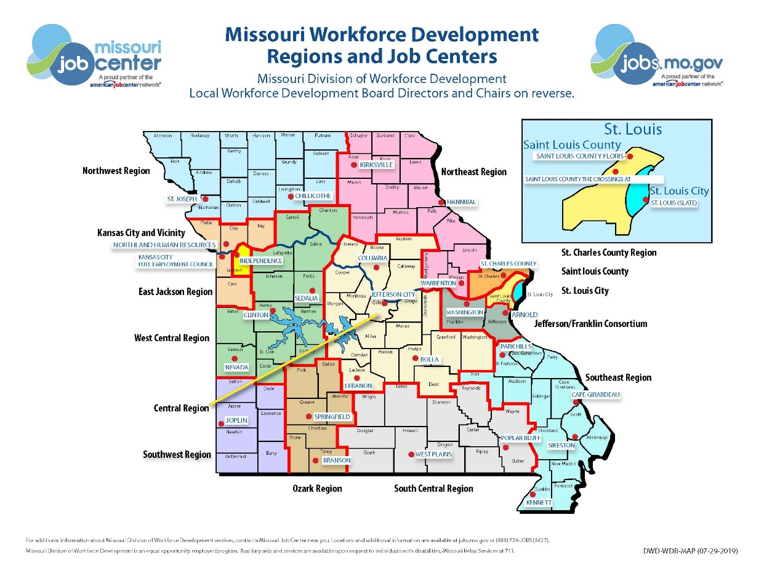
WIOA Section 188 Discrimination Complaint Filing Options
You may contact your Local EO Officer at:
Jobs.mo.gov – Equal Opportunity Section, or on
OWD Main: https://jobs.mo.gov/dwdmain
Equal Opportunity and Disability Resource Section
Notes:
Presenter
2020-02-21 20:03:57
--------------------------------------------
Everyone should be aware of their Local EO Officer. If you are not, you can locate the Local EO Officer contact information on jobs.mo.gov or on OWD Main

Slide 14
WIOA EO Orientation
All Recipients must provide initial and continuing notice regarding the rights and responsibilities under the nondiscrimination and equal opportunity provisions of WIOA. You have the right to file a complaint of discrimination with:
DHEWD Human Resources
Missouri Human Rights Commission
EEOC
State WIOA Equal Opportunity Officer, or the
U.S. DOL Civil Rights Center (CRC)

Slide 15
WIOA Section 188 Discrimination Complaint Filing Options
It’s the Complainant’s choice!
Notes:
Presenter
2020-02-21 20:03:57
--------------------------------------------
All discrimination complaints must be reported to the state regardless of where the complaint was filed. DHEWD process all discrimination complaints filed at the level and the state level.

Slide 16
WIOA Discrimination Complaint Procedures
Complaint must be in writing
Complainant’s name/address or another means of contacting the complainant
Identity of the Respondent (individual or entity alleged to have discriminated)
Allegations described in sufficient detail to determine whether:
Complaint is covered under Section 188 of WIOA and the Recipient’s jurisdiction
Complaint was filed within specified time
Complaint has apparent merit
A signature from the complainant or their authorized representative
Notes:
Presenter
2020-02-21 20:03:58
--------------------------------------------
It is not mandatory to use our complaint form. As long as the complaint is in writing it is acceptable.

Slide 17
Types of WIOA Discrimination Complaints
Individual Complaint: This is an individual alleging that they have been subjected to discrimination.
Class Action Complaint: One or more individuals, alleging discrimination against another group or individual that has been subjected to discrimination.
Third Party Complaint: This action is not only on behalf of themselves, but also on behalf of a group of similarly situated individuals.

Slide 18
WIOA Discrimination Complaint Procedures
A complaint must be filed:
Within 180 days of the alleged discrimination
The Director of the CRC can only grant an extension of the 180-day filing period for good cause shown by the complainant.
Notes:
Presenter
2020-02-21 20:03:58
--------------------------------------------
The complainant must request the extension from the CRC director only.

Slide 19
WIOA Discrimination Complaint Due Process Guarantees
DHEWD EO Unit must notify Complainants of their rights to:
Representation
Present evidence
Question others who present evidence
File with CRC when they are not satisfied with an agency’s decision
Notes:
Presenter
2020-02-21 20:03:58
--------------------------------------------
Respondents will receive the right for presentation and to submit evidence. The Alternate dispute (mediation) is only for the Complainant to decide.

Slide 20
Specific WIOA Discrimination Required Elements
Initial written notice
Written statement of issues
Process for fact-finding
Alternative Dispute Resolution (Mediation)
Written Notice of Final Action
Notes:
Presenter
2020-02-21 20:03:58
--------------------------------------------
Individual filing, also known as “Complainant”, selects process, either:
1. Alternative Dispute Resolution (ADR) also known as mediation, or
2. Investigation
*** The Complainant decides which option he/she would like to pursue The EO Officer issues a written Notice of Final Action within 90 days.
The complainant has a right to file with the US Department of Labor-Civil Rights Center (CRC) within 30 days if they are not satisfied with the outcome of the complaint.

Slide 21
Note: Confidentiality
The identity of any person who has furnished information relating to or who has assisted in the investigation of a possible violation of the nondiscrimination and equal opportunity provisions of WIOA shall be kept confidential to the extent possible, consistent with the need to conduct a fair review of the issues.
Notes:
Presenter
2020-02-21 20:03:58
--------------------------------------------
For any complaint

Slide 22
Harassment is Prohibited under WIOA
Harassment of an individual based on race, color, religion, sex, national origin, age, disability, or political affiliation or belief, citizenship status or participation in any WIOA Title I-financially assisted program or activity, is a violation of the nondiscrimination provisions of WIOA.

Slide 23
Retaliation
Retaliation against, or intimidation of, anyone who takes any of the following actions related to nondiscrimination or equal opportunity is prohibited under WIOA:
Filing a discrimination complaint
Opposing a practice that is made illegal by civil rights law
Giving information to, testifying at, or taking part in any other way in an investigation, a compliance review, a hearing, or any other type of civil rights-related activity.
Notes:
Presenter
2020-02-21 20:03:57
--------------------------------------------
Otherwise exercised any rights and privileges under the nondiscrimination and equal opportunity provisions of WIOA or this part.
The sanctions and penalties contained in Section 188 of WIOA and in the Missouri Nondiscrimination Plan may be imposed against any recipient that engages in any such retaliation or intimidation, or fails to take appropriate steps to prevent such activity.

Slide 24
Criminal Fraud, Waste and Abuse
Must be reported immediately
Through USDOL’s Incident Reporting System to the DOL Office of Inspector General, Office of Investigations, Room S5514, 200 Constitution Avenue NW., Washington, D.C. 20210; or
The Hotline number is 1-800-347–3756.
Website: https://www.oig.dol.gov/hotlinecontact.htm

Slide 25
Next Steps:
Complete WIOA EO Orientation Notice form(DWD EO (10-28-19))
Please sign and submit these forms to your employer of record.
DHEWD staff (ONLY) must submit these forms to:
DHEWDHR@dhewd.mo.gov
Notes:
Presenter
2020-02-21 20:03:59
--------------------------------------------
This form is used for participants, applicants for employment and employees. You must sign this form and have your immediate supervisor sign off on it and submit this form to your employer of record.

Slide 26
Thank You
Danielle Smith, State WIOA Equal Opportunity Officer
Email: danielle.smith@dhewd.mo.gov
Phone:(573)751-2428, Missouri Relay at 711
Harli Rhodes, Policy Director/EO Investigator
Email: Harli.Rhodes@dhewd.mo.gov
Phone: (573)526-8242, Missouri Relay at 711
Isaac Hagan, Senior EO Data Analyst Benefit Specialist
E-mail: isaac.hagan@dhewd.mo.gov
Phone: (573)751-8626, Missouri Relay at 711
Missouri Department of Higher Education and Workforce Development is an equal opportunity employer/program. Auxiliary aids and services are available upon request to individuals with disabilities. Missouri TTY User: 711 for Relay Missouri.

