Slide 1
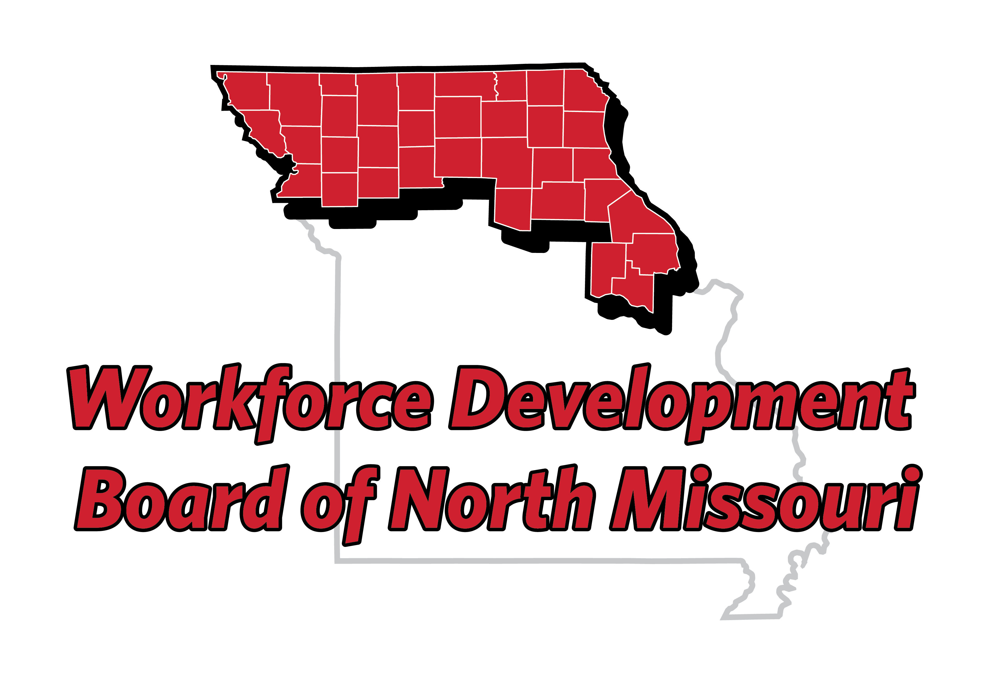
Strategic Planning 2024
February 13, 2024
Chillicothe Country Club

Slide 2

Board Member/Guest Introductions
Tell us your name and Business or Partner Organization that you represent.

Slide 3
Guest Speakers
Mark Bauer
Rebecca Fletcher

Slide 4
Lunch

Slide 5

State WDB Vision/Mission
Vision
The vision of the WDB is to prepare Missourians to enter the workforce with marketable skills and to provide businesses with recruitment assistance to find workers with the skills they need.
Mission
The mission of the WDB is to engage employers, education providers, economic development, and other stakeholders to help the workforce development system achieve the purpose of WIOA and the State's strategic and operational vision and goals outlined in the State Plan.

Slide 6
Missouri WDB Focus Areas
Focus Area | Description
Job Center Operations | Training staff to listen and guide customers to decisions, providing customer experience training to be a resource and understand partner services, build partnerships, and review the customer experience business process. This aligns with the State Combined Plan strategy to improve service design and delivery, and the goal of maximizing efficiency and access to services.
Technology | Focus on the growth and development of small businesses in utilizing the MoJobs labor market information system, formation of an ongoing technology assessment committee, and continuing to meet customers and job seekers where they are through the use of technology. This supports the strategy in delivering services to employers, employer engagement as a goal, and maximizing efficiency and access to services.
Training | Support the workforce system in development of training partnerships and becoming a training resource, and work with employers to identify employer training needs at different career points (entry, mid, and advanced levels). This aligns with the strategy to implement policies and practices for service design and delivery for all citizens, including youth, and engaging employers.
Public Awareness | Provide and deliver a consistent message about workforce services, and focus on the customer experience. This specifically addresses one of the Missouri public workforce system weaknesses of messaging and ensuring that citizens are aware of the services provided and have access to them.

Slide 7

State Plan Goals
Goal 1 – Overcome Employment Barriers
Goal 2 – Maximize Efficiency and Access to Services
Goal 3 – Develop Career Pathways
Goal 4 – Place a Strong Emphasis on Employment Retention
Goal 5 – Engage Employers to Meet their Needs

Slide 8
1 Year Change -593
5 Year Change -4,154 (Avg -830/year)
1 Year Change +12,888
5 Year Change +79,122 (Avg +15,824/year)

Slide 9
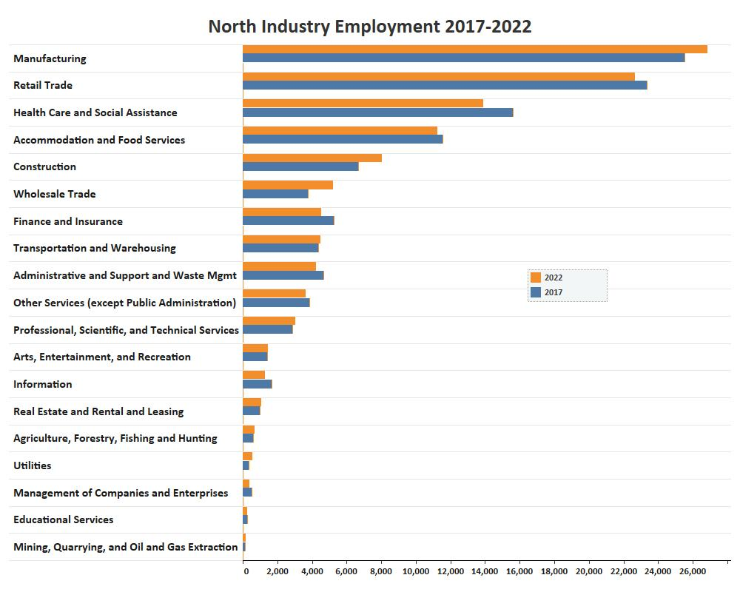

Slide 10
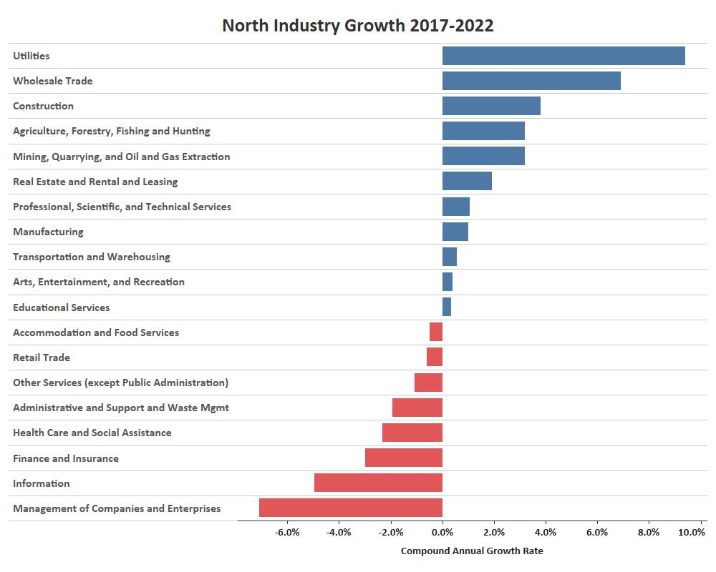

Slide 11
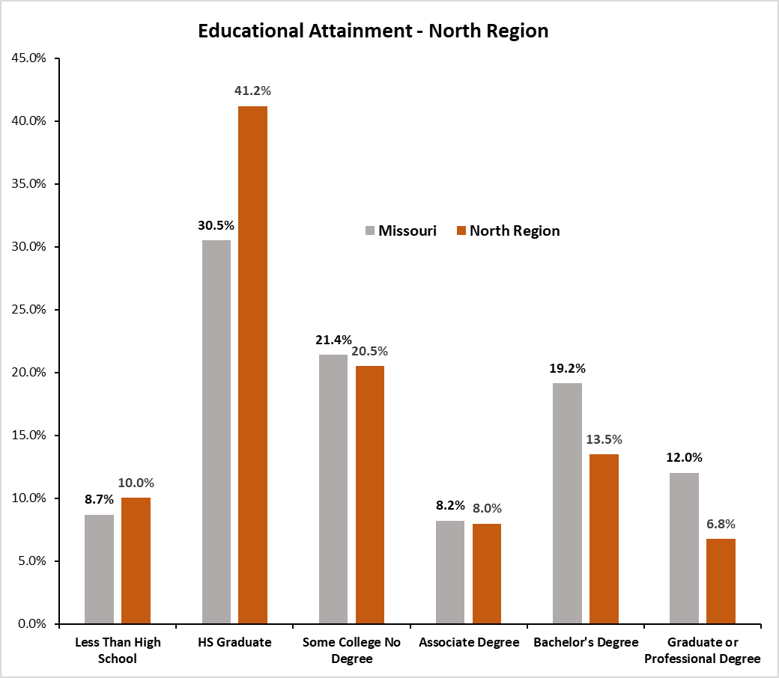

Slide 12
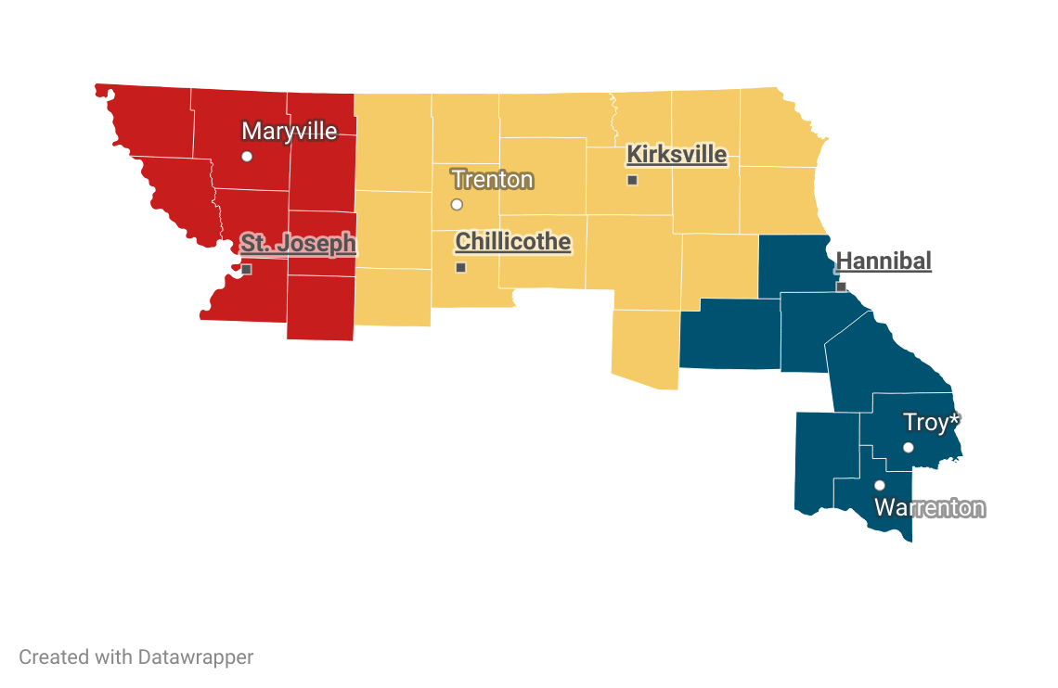
Review of Region
Comprehensive Job Centers
  Chillicothe
  Hannibal
  Kirksville
  St. Joseph
Affiliate/Access Points
  Maryville
  Trenton
  Troy*
  Warrenton

Slide 14
Job Center | 2022 Avg Weekly Visitors | 2023 Avg Weekly Visitors | Percent Change
Chillicothe | 14.96 | 15.81 | 5.68%
Hannibal | 36.73 | 57.81 | 57.39%
Kirksville | 32.67 | 36.00 | 10.19%
St. Joseph | 86.98 | 120.60 | 38.65%

Slide 15
Sub-Region | 2022 | 2023 | Percent Change
Central | 1248 | 1302 | 4%
East | 1000 | 1065 | 7%
West | 2088 | 2369 | 13%
Total | 4705 | 5262 | 12%

Slide 17
WDB North Missouri Mission/Vision
Former Northeast Vision:
The vision of the Northeast Missouri Workforce Development Board (NEMO WDB) is that of a skilled workforce that supports the current and future needs of business and industry, and enhances the economic prosperity of the citizens of the Northeast Region in Missouri. The NEMO WDB functions as the convener in connecting, brokering, leveraging workforce system stakeholders The NEMO WDB provides coordinated and efficient use of workforce development resources, develops workforce policy, and maintains accountability for the resources.
Former Northwest Vision:
Through partnership with each local community, it is our vision that every employer will maintain a qualified, productive workforce; and that every job-seeker will have education and training opportunities, throughout their lifetime, which lead to a lasting, living-wage job commensurate with their abilities and goals.”

Slide 18
I feel the former NW Vision is best but could see an addition of something along the lines of what the NE had as a last sentence. “The NMO WDB provides coordinated and efficient use of workforce development resources, develops workforce policy, and maintains accountability for the resources.”
It is our vision that every employer will have the opportunity to source qualified and productive potential employees. We will also ensure that every potential job candidate will have access to appropriate education and training opportunities. This vision will improve the economic viability of the regions that we serve.
Through ongoing education and training, the WDB of North Missouri will foster collaboration through partnership with local community business to provide a skilled workforce that supports the current and future needs of those businesses.

Slide 19
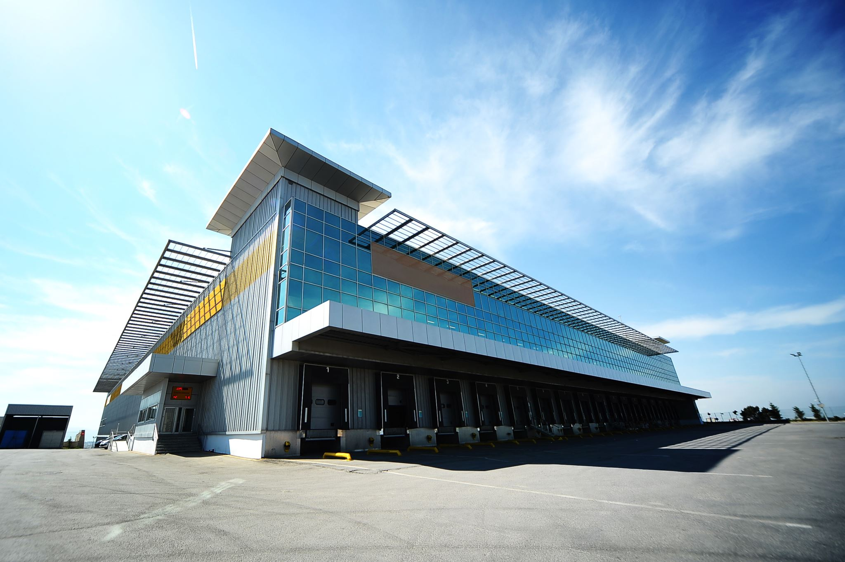
What is our Vision?
What does the future of North Missouri look like if we achieve our goals?
What are our key deliveries?
  Skilled Workforce
  Meet the Needs of Business
  Productive Workforce
How do we know we made it?
  Economic Prosperity
  Living-Wage
It is our vision that North Missouri has a productive and skilled workforce that meets the ever-changing needs of business so the citizens can earn a living wage while leading the region to economic prosperity.

Slide 20
What is our Mission?
How do we make our vision happen?
  What services do we offer?
    Skills Training
    Job Matching
    Career Pathways
  How do we ensure our services are effective?
    Community Partnerships
    Accessible Locations
    Understanding of Business/Employer Needs
    Policy Development
    Oversight/Accountability of Federal and Local Resources
    The mission of the Board is to enhance the regional workforce development system by connecting jobseekers with quality jobs and businesses with a skilled workforce. We will achieve this through community partnerships, collaboration with businesses, and accessible service delivery throughout the region, while ensuring oversight and accountability for federal and local resources.

Slide 21
Goals of the Board
Improve the coordination of services amongst programs in the region delivering workforce programs.
Increase the number of job seekers utilizing Job Center services.
Increase the number of employers in the region utilizing Job Center services.
Increase the number of partners delivering services in the Job Center to be more of a “One-Stop Shop” for Job Seekers and employers.
Outreach to the population who has left the workforce to re-engage them in the workforce (increase labor force participation rate).
Increase the region’s population higher education credential attainment rate.

Slide 22
Priorities of the Board
Work with employers to identify skill needs and work with local training providers to develop training programs to address these needs.
Work with Employers to promote and create apprenticeship opportunities in North Missouri.
Assist all jobseekers by identifying and assisting them overcome barriers to employment.
Work with employers to create on-the-job training work experience opportunities for jobseekers.
Increase usage of technology for service access (i.e. Virtual Job Centers)
Enhance Workforce Development service delivery and availability to the entire region (meet the people where they are, not where we want them to be).
Hosting hiring events/job fairs.
Addressing soft skill issues through workshops for jobseekers.
Promote in-demand employment sectors and create career pathways to show jobseekers career growth opportunities.
Be a resource for employers to skill up their current workforce to promote job creation and business productivity.

Slide 23
THANK YOU!
Next Board Meeting is Tuesday March 5th

